Slide 1
Geoethics in a scheme: a simplified way to represent its definition, vision, and theoretical structure
Silvia Peppoloni
silvia.peppoloni@ingv.it
Giuseppe Di Capua
giuseppe.dicapua@ingv.it

Slide 2
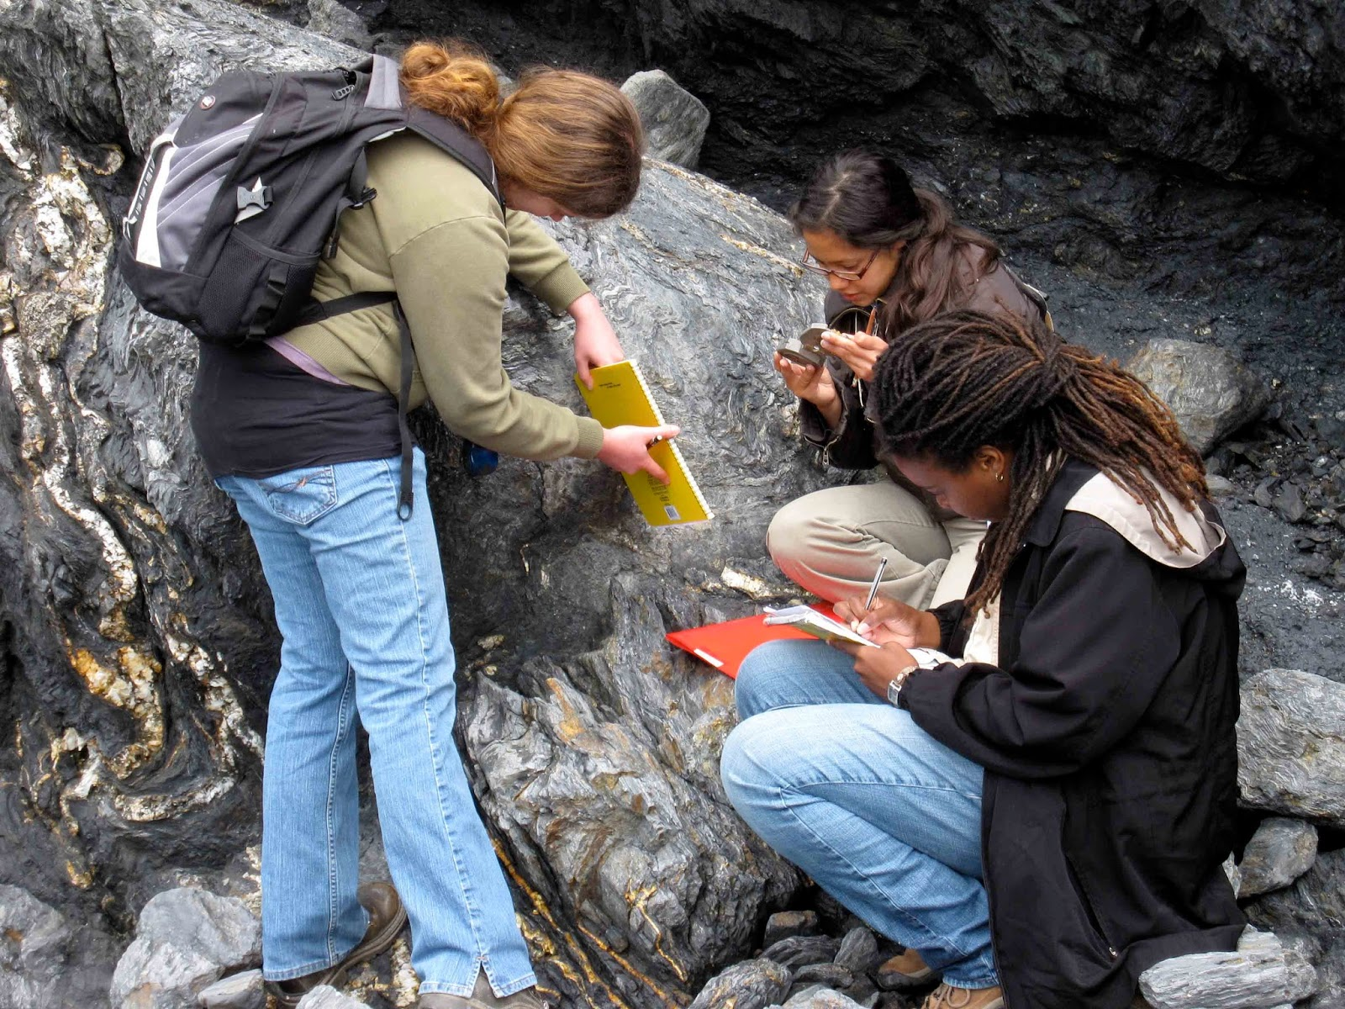
Geoethics and Geosciences
Picture credit:
http://www.geologyin.com/2015/10/what-makes-geology-different-from-other.html
Geoethics initially developed in the context of geosciences, as a rediscovery of the social role geoscientists can and should play in support of society in facing global anthropogenic changes.

Slide 3
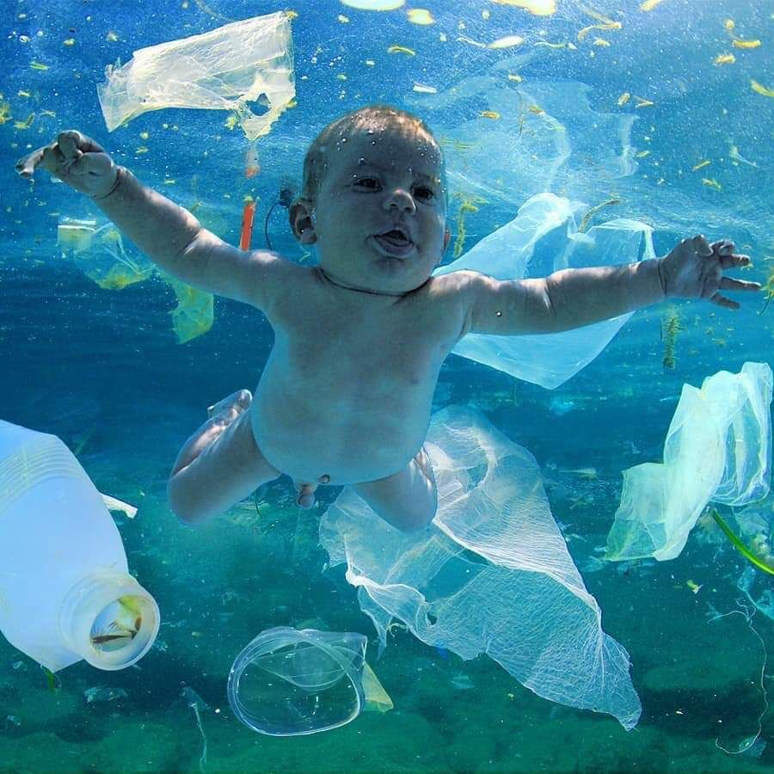
Geoethics and Society
Geoethics aims to define cultural categories and behavioural values based on experience and scientific knowledge, which contribute to guiding human beings towards more responsible individual and social choices.

Slide 4
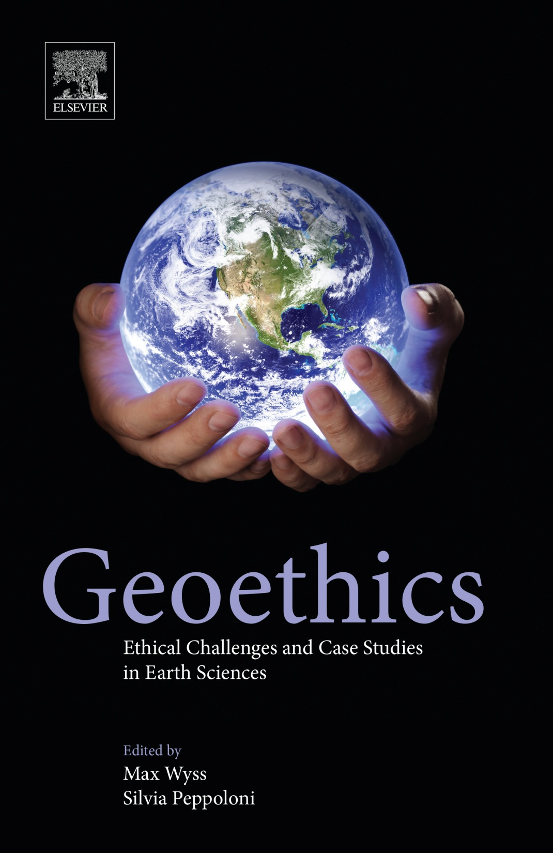
Definition of Geoethics
“Research and reflection on the values which underpin appropriate behaviours and practices, wherever human activities interact with the Earth system. Geoethics deals with the ethical, social and cultural implications of geoscience knowledge, education, research, practice and communication and with the social role and responsibilities of geoscientists.”
(Peppoloni et al., 2019)

Slide 5
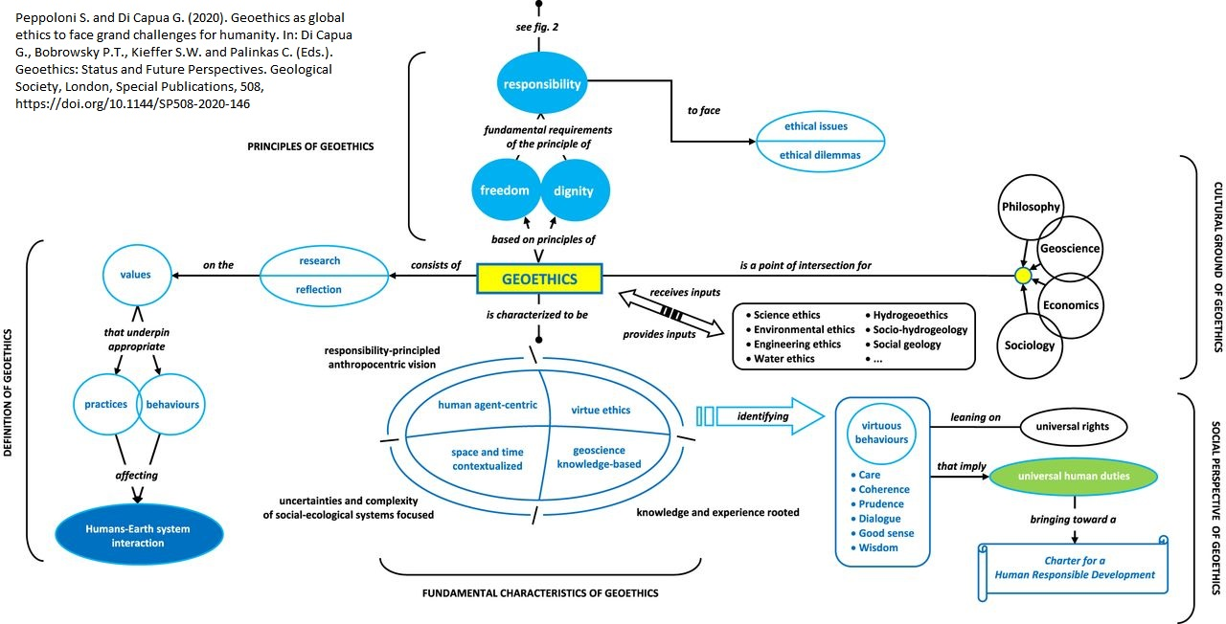
A scheme of Geoethics 1/2

Slide 6
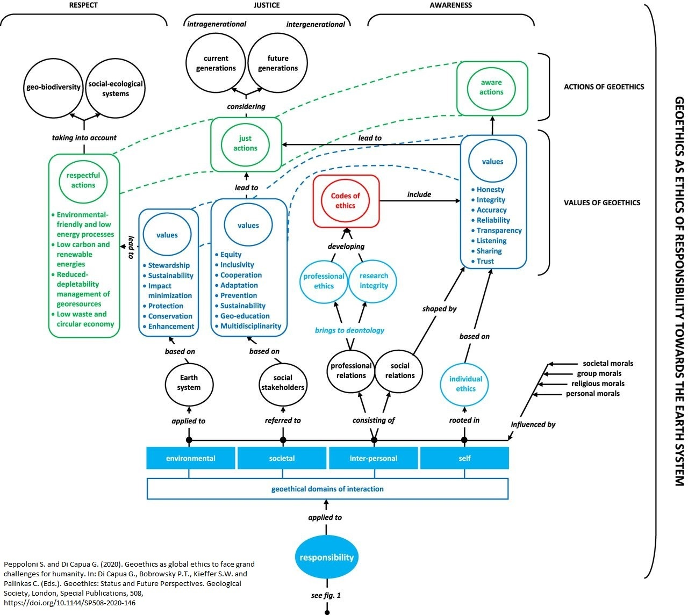
A scheme of Geoethics 2/2
Peppoloni S. and Di Capua G. (2020). Geoethics as global ethics to face grand challenges for humanity. In: Di Capua G., Bobrowsky P.T., Kieffer S.W., Palinkas C., eds. Geoethics: Status and Future Perspectives, Special Publication 508, Geological Society of London. doi: 10.1144/SP508-2020-146.
This scheme may become a proposal on which to base a new pedagogy for our societies based on geoscience knowledge.

Slide 7
Thanks for yoUr attention
Silvia Peppoloni
Istituto Nazionale di Geofisica e Vulcanologia
silvia.peppoloni@ingv.it
Giuseppe Di Capua
Istituto Nazionale di Geofisica e Vulcanologia
giuseppe.dicapua@ingv.it

