Slide 1
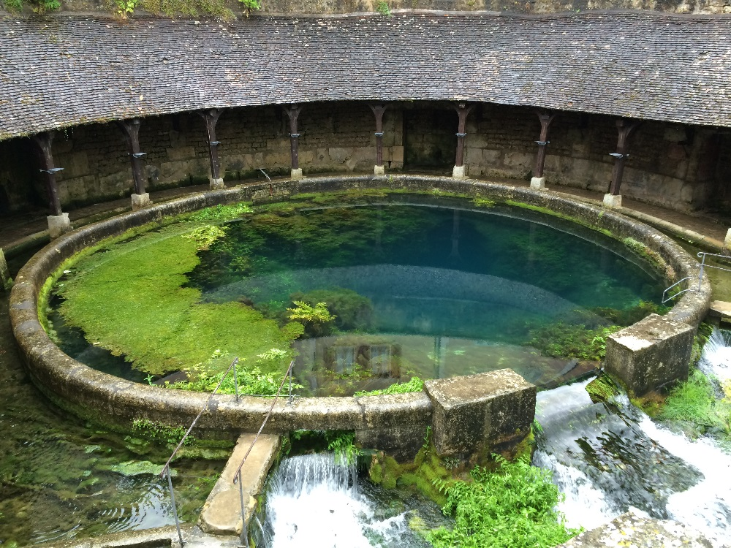
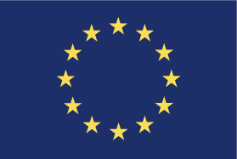
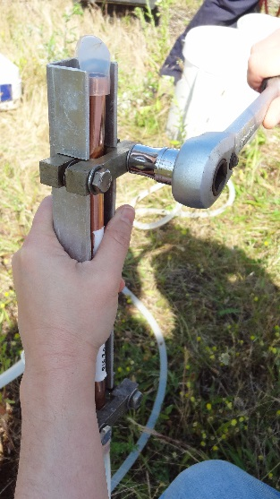
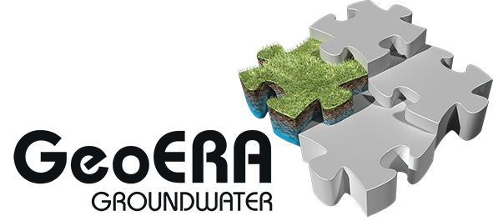
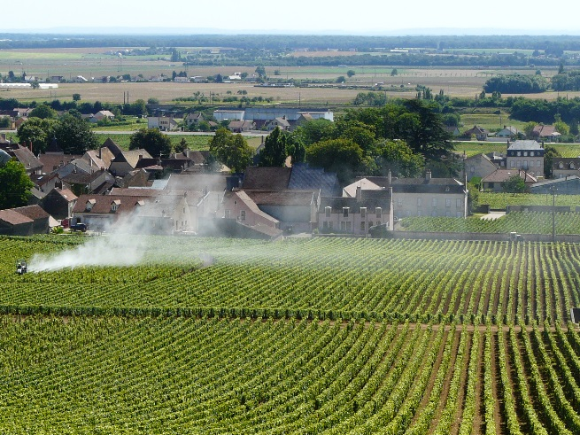
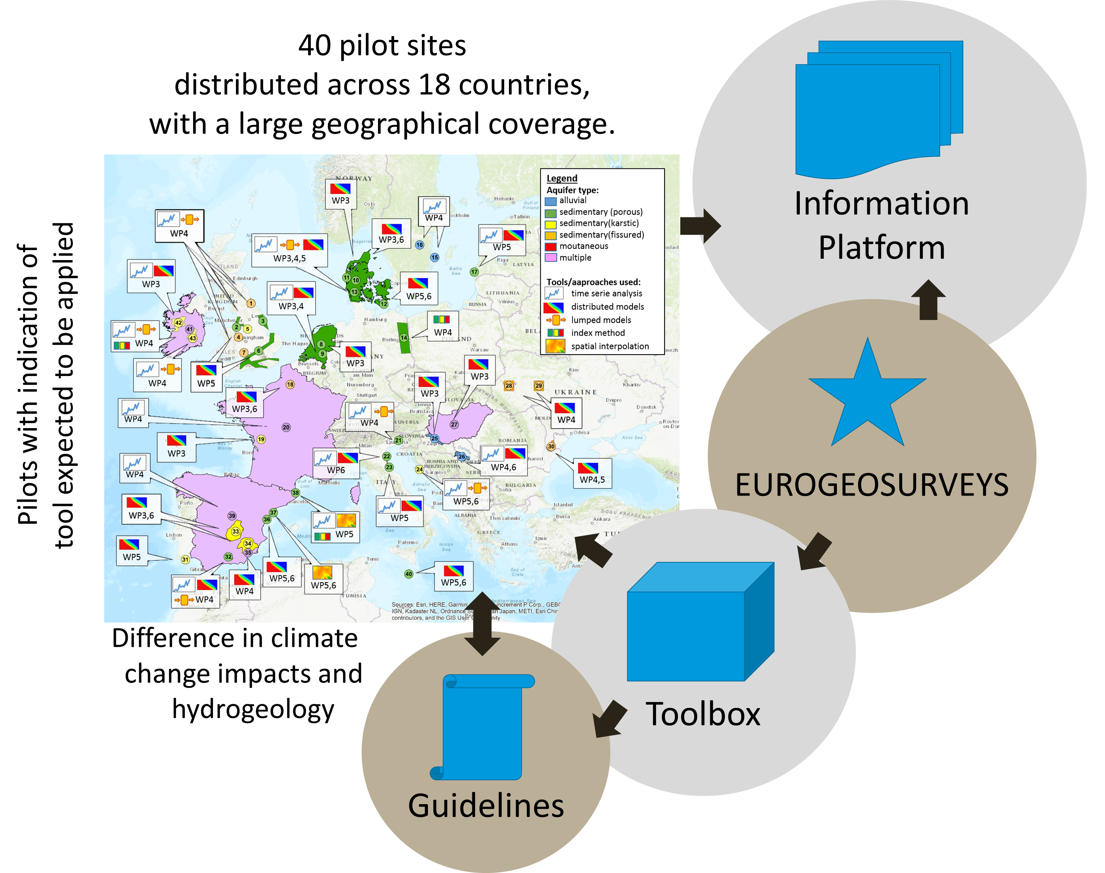
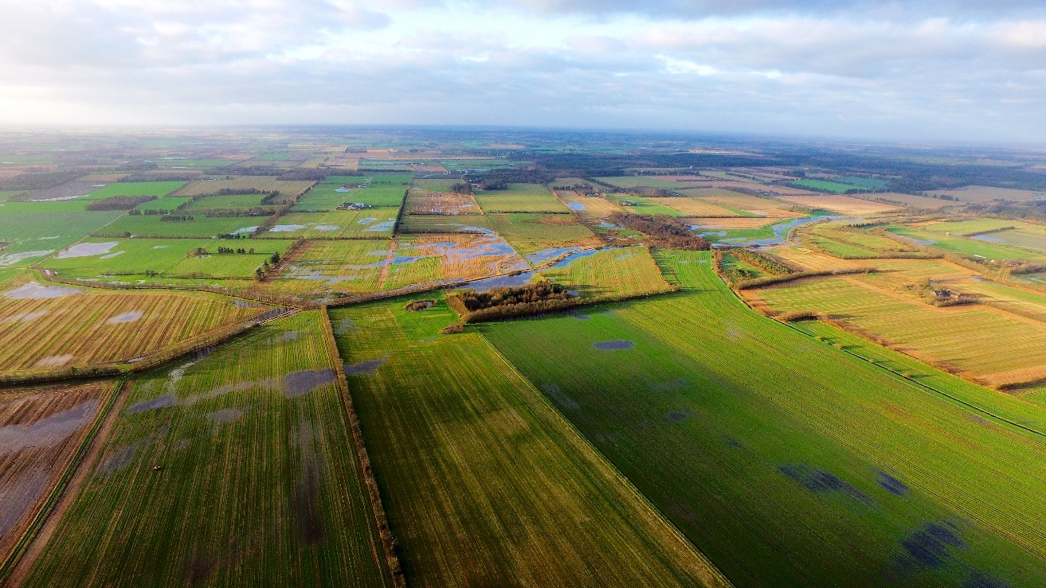
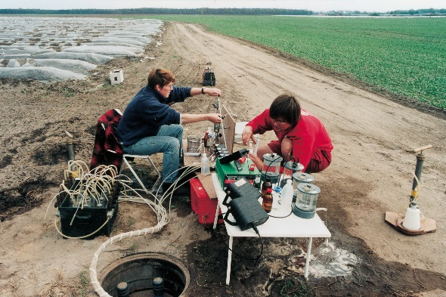
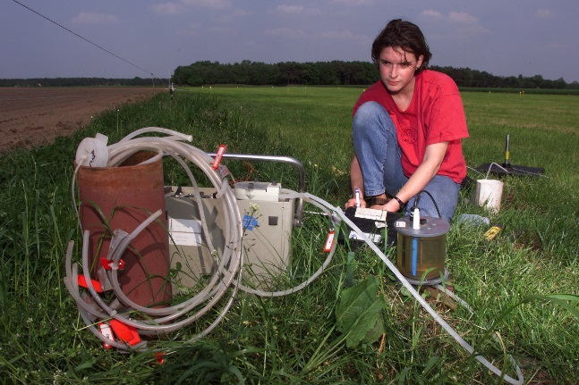
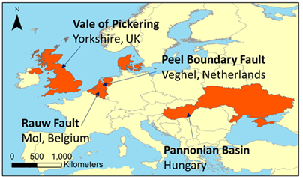
X4.375 | EGU2019-18215
Use of the European Geological Data Infrastructure for safeguarding Europe’s groundwater resources and dependent ecosystems
HOVER
Hydrogeological processes and geological settings over Europe controlling dissolved geogenic and anthropogenic elements in groundwater of relevance to human health and the status of dependent ecosystems
Authors: Klaus Hinsby, Laurence Gourcy, Hans Peter Broers, Anker L. Højberg, Sian Loveless, Ida B. Karlsson
Vision
The project will address groundwater management issues related to drinking water, human and ecosystem health across Europe in relation to both geogenic elements and anthropogenic pollutants by data sharing, technical and scientific exchange between European GSOs.
This project has received funding from the European Union’s Horizon 2020 research and innovation programme under grant agreement No 731166
Evaluating health risks and spatial variability of concentrations of geogenic elements assessing thermal and mineral water
Increase understanding of ecology and microbial diversity controls on transforming pollutants at groundwater-surface water transition zones
Quantify groundwater age distributions and nitrate and pesticide travel times and pollution trends
Develop harmonized aquifer vulnerability maps
Develop common standards, databases and maps
Introduction
Main tasks
TACTIC
Changes in the quantity and quality
of groundwater and water in the hydrological cycle
in general have important implications for the evolution of water
resources, the built environment, and terrestrial and aquatic ecosystems, globally.
It is the mission of the four GeoERA groundwater projects studying aspects of groundwater quantity and quality issues related to natural processes and human activities to provide groundwater quantity and quality data for the European Geological Data Infrastructure (EGDI) and develop this as a leading information platform for groundwater data in Europe and one of the leading platforms, globally.
Sound groundwater data is a prerequisite for sustainable management and protection of subsurface water resources for present and future generations.
The four groundwater projects providing data for EGDI are:
HOVER
RESOURCE
TACTIC
VoGERA
Tools for assessment of climate
change impact on groundwater and
adaptation strategies
RESOURCE
Vision
The vision and mission of TACTIC is to improve the use and access to data and knowledge of the subsurface system acquired by the Geological Survey Organisations (GSO) in Europe for the use in climate change impact assessments and adaptation.
Resources of groundwater, harmonized at cross-border and Pan-European Scale
Vision
A coherent overview of all fresh groundwater over Europe is not available for policy development and evaluation. The RESOURCE project aims at demonstrating the potentials of the harmonization of information about Europe’s groundwater resources.
Good practices for harmonized data and information across borders for assessments of:
3D structure of aquifers
water volumes available
water fluxes and water quality
Cross-border demonstrations projects
Pan-European map of the fresh groundwater resources
Main tasks
Develop toolbox and guidelines
Application and demonstration of tools in climate assessment pilots
Making pilot results accessible via the GeoERA website and Information Platform (EGDI)
Main tasks
VoGERA
FAIR data
Findable, Accesssible, Interoperable and Reusable
Vulnerability of shallow
groundwater resources to deep sub-surface
energy-related activities
The four projects will deliver “FAIR” data - https://www.go-fair.org/fair-principles/ following EU Horizon 2020 guidelines via the European Geological Data Infrastructure (EGDI) and the GeoERA website (see links below). The websites provide easy access to data visualization and download. FAIR data will improve our understanding of the subsurface and support common efforts to develop sustainable and geoethical uses of the subsurface based on geoscientific data and principles.
Vision
The project will consider the possible impacts on groundwater from a range of sub-surface energy activities (geothermal energy, unconventional oil and gas exploitation, sub-surface storage and disposal of wastes)
Development of conceptual models of shallow groundwater vulnerability to deep sub-surface energy activities
Investigations into contamination pathways at four case study sites
Development of a tool for use by decision makers to assess shallow groundwater vulnerability
Visit GeoERA and the four groundwater projects at: https://geoera.eu
Main tasks
GeoERA Information Platform / European Geological Data Infrastructure (EGDI) at: http://www.europe-geology.eu/

